Slide 1
A Site Administrator’s Guide:
Talking to Educators About the California Physical Fitness Test (PFT)

Slide 2
Intent of This Deck
  This slide deck is intended for use by site administrators to provide information to Educators about the PFT. It includes:
  A description of what the PFT is
    An overview of how the PFT is given
    Information on who takes the PFT
    An overview of test administration for the PFT
    Information on how test results are reported
    Available resources for educators related to the PFT
    Information on Tools for Teachers

Slide 3
How to Use This Deck (1)
This deck has been created for you to customize and edit as needed:
  Choose the slides you want to use.
  Select the “View” tab, and then select “Normal.”
  In the slide list on left, right-click on the slide you do not want and select “Hide Slide” at the bottom of the menu.
  Add your school’s logo and change colors.
  Change wording for your audience—you know your audience best!
  Talking points are provided in the “Notes” section that can be customized to your audience.

Slide 4
How to Use This Deck (2)
  Change color scheme.
      Select “View” tab, and then “Slide Master.”
        For titles, select slide ─ highlight header text ─ select “Home” tab ─ choose text color ─ return to “View” tab.
        For the body, select slide ─ highlight body text ─ select “Home” tab ─ choose text color ─ return to “View” tab.
        For the green line, select slide ─ highlight line ─ select “Home” tab ─ select “Shape Outline” ─ choose color ─ return to “View” tab.
        When all changes are made ─ select “Slide Master” tab ─ select “Close Master View.”
  The changes should apply to all slides in the deck.

Slide 5
Suggested Handouts
Assessment Fact Sheet
  https://pftdata.org/files/pft-factsheet.pdf
Reference Guide for Test Administrators
  https://pftdata.org/files/PFT15-16_Reference_Guide.pdf
Parent Guide to Understanding
  https://pftdata.org/files/pft-pgtu.pdf

Slide 6
Understanding the California Physical Fitness Test (PFT)
For Educators
[Add school logo here, if desired.]
[Add school motto here, if desired.]
Notes:
Today we will be reviewing one of the ways that we measure how our students here at [insert school name] are doing in the area of physical fitness.
Let’s get started!

Slide 7

Goals for This Session
Introduce the PFT
Understand how the PFT is structured
Learn about important resources
Notes:
Let’s take a moment to review the learning goals for today.
We are first going to introduce the PFT and understand how it is structured. Then we hope to help you learn about important resources that can help you administer the PFT assessment.

Slide 8

Why:
The primary goal of the FITNESSGRAM is to assess the physical fitness of students.
Notes:
You may be wondering why students take the PFT?
As with any test result, the PFT is just one piece of information about how our students are doing.
The primary goal to the FITNESSGRAM is to assist in establishing lifetime habits of regular physical activity.
The PFT provides information useful to:
Students – for their own planning
Teachers – to plan their PE lessons
Parents/Guardians – to understand their children’s fitness level

Slide 9


What:
Notes:
The PFT is part of the statewide assessment system and it is one of the ways that California schools determine the physical fitness and health of students.
The PFT is a battery of comprehensive, health-related, physical fitness tests.
The information from this test can be to decide how effective our physical fitness curriculum is and what changes might be beneficial.
The test given to students in California is the FITNESSGRAM® developed by the Cooper Institute. It was chosen as California’s test of physical fitness by the State Board of Education.

Slide 10

Who:
Notes:
The PFT is given to all students enrolled in a California public school in grades five, seven, and nine.
Students with disabilities should be given as much of the test as each student’s physical condition permits.
As with all assessments, the individualized education program, also referred to as the IEP, or Section 504 plan team is responsible for deciding how students with disabilities will participate in the PFT.

Slide 11
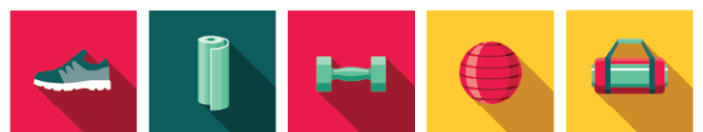
How:
Aerobic Capacity
Abdominal Strength and Endurance
Upper Body Strength and Endurance
Trunk Extensor and Flexibility
Flexibility
Notes:
How is the PFT is given to students?
The PFT can be spread out over multiple days, but it may be administered all at one time.
Students will take at least one test option for each of the fitness areas in the PFT.
A student will get a score in the Healthy Fitness Zone or in the Needs Improvement area.
The goal is to be in the Healthy Fitness Zone. This means the student can reach a level of activity to be protected against diseases caused by inactivity.
A score of Needs Improvement in a fitness area means that student’s health would benefit from more activity in that fitness area.
I’m going to spend just a few minutes talking about the different options so you have a better understanding about what students will be asked to do.
For Aerobic Capacity there are three test options:
One mile run
Walk test
PACER
For Abdominal Strength and Endurance there is only one option, the Curl Up.
For Upper Body Strength and Endurance there are three test options:
Push-Up
Modified Pull Up
Flexed Arm Hang
For Trunk Extensor Strength and Flexibility there is only one option, the Trunk Lift.
For Body Composition there are three test options:
Skinfold Measurement
Bio-electric Impedance analyzer
Body Mass Index
For Flexibility there are two test options:
Back-Saver sit and reach
Shoulder stretch

Slide 12

When:
February 1
through
May 31
Notes:
The PFT test administration window is February 1 through May 31.

Slide 13
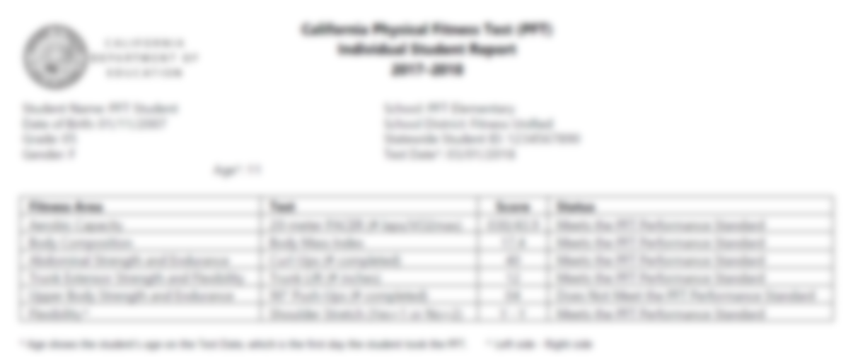
Results
Notes:
Individual Student Results will be available by the fall following the test administration.
Student Score reports will show:
Student demographic Information.
School and district information
The six fitness areas
Lists which test option the student took under each area
Displays the score the student received on each test
Here at [insert school name] we give this information to families by [insert method of sending out scores here].

Slide 14

Want to Learn More? Assessment Fact Sheets
Notes:
Let’s talk for a moment about the handouts provided through links at the beginning of this session.
You will find them helpful in learning more about the PFT and communicating the pertinent information with families of your students.
The first one I wanted to mention is a series of documents called Assessment Fact Sheets. You may use these to learn general information about the what?, why?, who?, how?, and when? of the different parts of the PFT.
These documents are updated annually so they represent the most current information available and contain links to CDE web pages where you can find more information about each assessment.

Slide 15
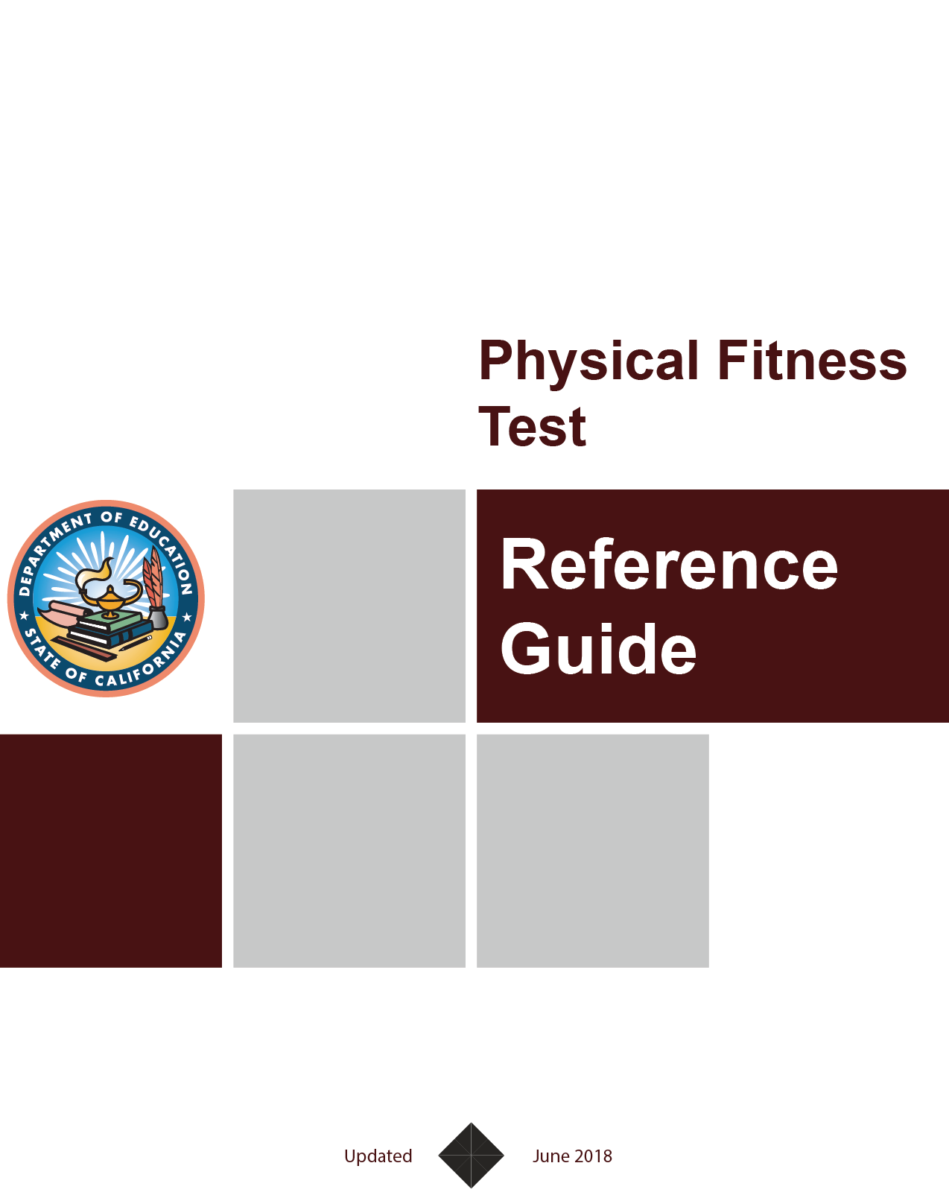
Want to Learn More?
Test Administrator Reference Guide
Notes:
Next, we have the PFT Reference Guide.
This manual explains all possible PFT test options to test administrators as well as giving tips and tricks for how to administer the PFT.

Slide 16
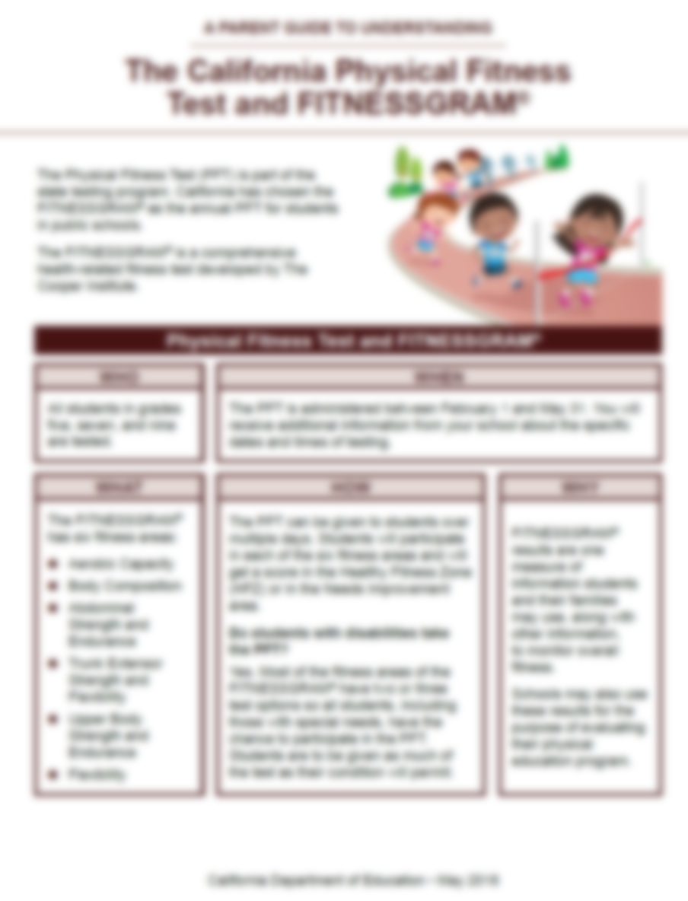

Want to Learn More?
Parent Guides to Understanding
Notes:
And finally, we have the Parent Guides to Understanding.
This also cover the basics of who?, what?, when?, why?, and how? of the PFT.
It provides information in a more parent-friendly language and are available on the CDE website in the top seven languages spoken in California.
These handouts would be great to provide to parents at the parent/teacher conference or even at the back-to-school night.

Slide 17

Family Engagement
Discuss with the parents of your students:
  In what areas their child is doing well?
  In what areas their child might need some extra support?
  How can they help support their child at home?
  How are you supporting their child at school?
Notes:
I would also like to call out the things parents would like to know about their child’s progress in school.
When you talk to parents about their student’s PFT scores or physical fitness, you can discuss the following topics:
In what areas is their child is doing well?
In what areas might their child need some extra support?
How can they, and other family members, help support their child at home?
How can they support their child at school?

Slide 18
Questions?
Notes:
We have reached the end of this presentation.
Are there any questions I can answer?
Thank you!

Slide 19
Posted by the California Department of Education | December 2021

