Slide 1
SRC Examination Process
In association with:

Slide 2

Eligibility
Minimum age for examination is 16 years old
Have a completed exam application form
Should have completed SRC training:
  Online RYA SRC course
  Classroom RYA SRC course
  OR…………………..
Notes:
We are not able to issue an Authority to Operate to anybody under the age of 16 years old, therefore there is little point in taking the exam. They are able to
a) attend a training course in a classroom and have evidence recorded that they have completed the course i.e. exam application form signed by the instructor or,
b) course completion unique number from interactive course.
ONLY ORIGINAL application forms will be accepted, not photocopies. They are distributed with course packs.
Training is covered in the other two workshops, so best we don’t dragged into it.
Reference for this is on the exam application form. Min age on front cover and the sections for course completion in the

Slide 3
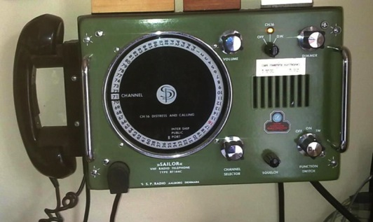
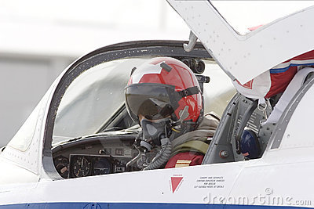
‘Old’ RYA VHF Certificate
  Aviation radio licences
Notes:
Holders of the older RYA VHF certificates may do the exam without completing a course, but we would strongly recommend they attend a training course, even if it is a short refresher / or coaching session. This coaching /training must not be by the examiner.
VHF certificate verification and registering of the certifcate number must be completed by the examiner and entered on the exam form. No need to submit the original certificate or a photocopy.
Aviation radio licences – not something that we will not be actively promoting on the application form or on the course packs, but we will accept UK aviation radio licences as evidence of training and therefore eligibility for the exam. Examiners should attach a photocopy of the licence.

Slide 4
There will only be one type of exam:
The SRC exam!
Notes:
There is now only one type of exam.
So no longer have a conversion exam and full exam. Just the exam which consists of a theoretical and practical assessment. The exam application form only has the one type on it..
The exam syllabus is available in REC3104E pdf (the resolution document).
No need to dwell on this too much, but it is there for them to see.
We have a slide about the practical exam requirements later.

Slide 5
Exam requirements
Must comply with CEPT resolutions i.e. examiner independent of instructor
Must take place at a centre recognised for SRC training
  Centre will have at least one pair of training radios, which are to be used for the examination
  A suitable classroom to sit the written paper
Notes:
Reference REC3104 for the sentence about overseen by independent examiner.
Must be conducted through a RTC recognised for SRC therefore having classroom and radios etc to facilitate the exam. The centre is expected to provide the facilitate the exam facilities, not the examiner.

Slide 6
Examiner
Any SRC Assessor is eligible to either teach a classroom course or conduct an examination a candidate
BUT must not examine a student who they have taught SRC classroom course
Notes:
As the instruction and assessment of the interactive course is set by the course itself, an assessor may act as support tutor for online learning for a student they assess provided no face-to-face instruction takes place. The subtle difference is that the online student only approaches the tutor for assistance i.e. coaching, not instruction. This help is often a short communication and a pointer to the relevant section of the book or course.
The examiner can work for the school in question. The payment will go to the examiner.

Slide 7
Familiarisation
Students must have sufficient time to familiarise themselves with the radio sets being used for assessment.
Examiner is able to supervise this.
REMEMBER – helping with ‘knobology’, NOT underlying principles and knowledge
Notes:
The centre must provide time for the student to familiarise themselves with the menu and functions of the VHF radios they will be using for the exam.
The amount of time will vary but each student should have 15 minutes contact time with the set, with the instruction and quick start guides.
They need to be familiar with:
-Power switch
-Volume
-Squelch
-H/L power
-Channel control
-Distress button and menus
-DSC call menus and buttons
Examiner may supervise this familiarisation period and help students find the correct buttons etc prior to exam commencing. This is also covered in a little more detail during the online course workshop.

Slide 8
Written Examination Papers
Papers:
E, F, G, H, J and K
Updated 1/2014
Assessor number: __________________
1/14
Notes:
Current exam papers E, F ,G ,H ,J ,K originally written in 2011 will continue to be used.
They have been slightly amended to ensure the terminology is consistent (not much change), but the will have a space for the assessor conducting the assessment to write in their assessor number. The new version will have 01/14 on the top right corner. They are available from certification department as before and model answers are available for those that need / require them.
Time for the exam is set at 30 minutes.
Completed (and marked) papers need to be kept by the centre for review at centre inspection.

Slide 9
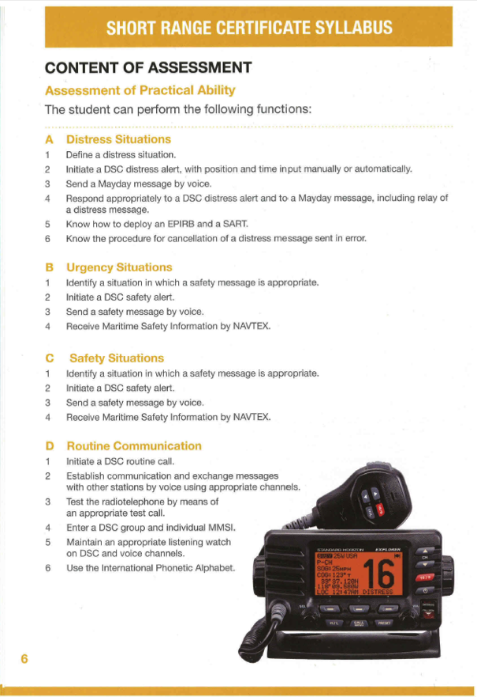
Practical exam
Notes:
Must use at least one pair of training radios in the exam.
Practical exam detail is in G26, however an extract based on G26 is included in the pack.
Assessors have all had a 2-day assessors course and most will have been delivering courses for a number of years, so there may be lively debate about what shoul and shouldn’t be in it. Common sense is the key
How long for the practical element of the exam? Would allow up 30 minutes per student, although may take less. Remember it is a coached assessment so we are not trying to trip them up.
Navtex – not all SRC centres have a working Navtex system, that will receive a message at the time of the exam. It is sufficient to provide a sample message to test their understanding.
Realistically you will not be able to examine more than 3 or 4 in one group – you will run out of meaningful questions and exercises- also keeping track of everyone will be more difficult, so may well need to break down the group into smaller groups.

Slide 10
Cost and payment
Cost to student is £60. Payable to the RYA
The examiner is paid by the RYA, £30 per student.
Notes:
Price is listed on the application form. It is a £10 reduction on the current full exam fee.
In your pack is a BACS form for you to submit your payment details to the RYA accounts dept. Payment will be made by BACS only and all payment paperwork will be delivered by email.

Slide 11
Finding an examiner
Contact lists of assessors to be available to centres.
Centres make arrangements locally.
Notes:
Contact list with email address and / or phone numbers for SRC assessors available for work at other centres will be available by region, as the YM examiners currently are.

Slide 12

Access to the SRC examination
Notes:
The expectation is that the centre selling the course will facilitate the exam, including arranging the examiner.
IF a student wishes to use another centres facilities for the exam and they are able to arrange it then this is allowed. We expect this to be rare, why would a student do training.
Examiners available for work will be available to RTCs, just as it is for Yachtmaster and Advanced power exams.

Slide 13
Post conference follow up requirements
Additional guidance for practical exam
Portability of the exam section
Examiner fees at non-commercial certain

